Slide 1
Software Testing
Lecture #4
[Static Unit Testing + Junit]

Slide 2
Static Unit Testing
In static unit testing code is reviewed by applying techniques:
Inspection: It is a step by step peer group review of a work product, with each step checked against pre-determined criteria
Walkthrough: It is review where the author leads the team through a manual or simulated executed of the product using pre-defined scenarios
The idea here is to examine source code in detail in a systematic manner
The objective of code review is to review the code, and not to evaluate the author of the code
Code review must be planned and managed in a professional manner
The key to the success of code is to divide and conquer
An examiner inspect small parts of the unit in isolation
nothing is overlooked
the correctness of all examined parts of the module implies the correctness of the whole module

Slide 3
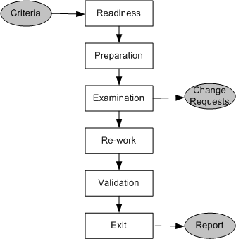
Static Unit Testing (Code Review)
Step 1: Readiness
Criteria
Completeness
Minimal functionality
Readability
Complexity
Requirements and design documents
Roles
Moderator
Author
Presenter
Record keeper
Reviewers
Observer
Step 2: Preparation
List of questions
Potential Change Request (CR)
Suggested improvement opportunities
Figure 3.1: Steps in the code review process

Slide 4
Static Unit Testing (Code Review)
A Change Request (CR) includes the following details:
Give a brief description of the issue
Assign a priority level (major or minor) to a CR
Assign a person to follow it up
Set a deadline for addressing a CR
Step 3: Examination
The author makes a presentation
The presenter reads the code
The record keeper documents the CR
Moderator ensures the review is on track
Step 4: Re-work
Make the list of all the CRs
Make a list of improvements
Record the minutes meeting
Author works on the CRs to fix the issue
Step 5: Validation
CRs are independently validated
Step 6: Exit
A summary report of the meeting minutes is distributes

Slide 5
Static Unit Testing (Code Review)
The following metrics can be collected from a code review:
The number of lines of code (LOC) reviewed per hour
The number of CRs generated per thousand lines of code (KLOC)
The number of CRs generated per hour
The total number of hours spend on code review process

Slide 6
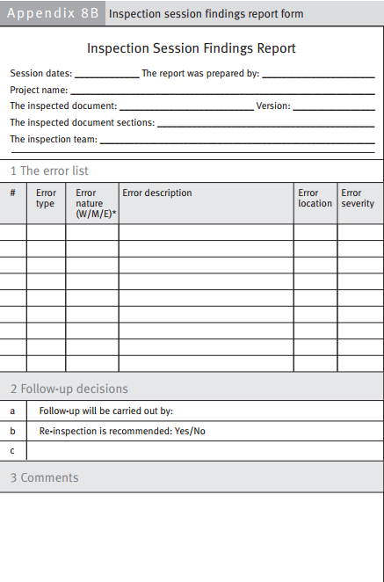
Notes:
W=Wrong, M =Missing, E= Extra

Slide 7
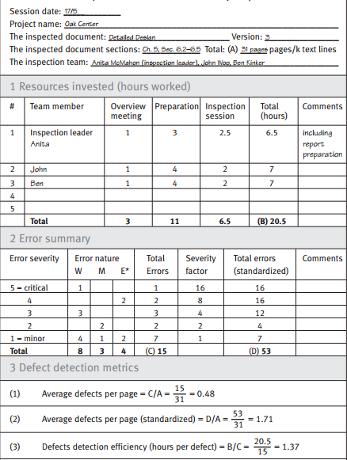

Slide 8
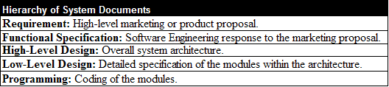
Static Unit Testing (Code Review)
The code review methodology can be applicable to review other documents
Five different types of system documents are generated by engineering department
Requirement
Functional Specification
High-level Design
Low-level Design
code
In addition installation, user, and trouble shooting guides are developed by technical documentation group

Slide 9
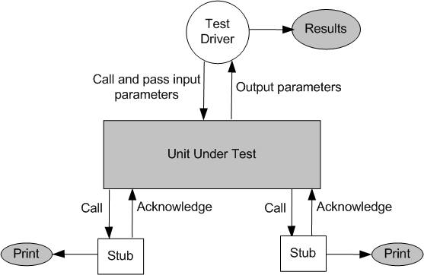
Dynamic Unit Testing
The environment of a unit is emulated and tested in isolation
The caller unit is known as test driver
A test driver is a program that invokes the unit under test (UUT)
It provides input data to unit under test and report the test result
The emulation of the units called by the UUT are called stubs
It is a dummy program
The test driver and the stubs are together called scaffolding
The low-level design document provides guidance for selection of input test data
Figure 3.2: Dynamic unit test environment

Slide 10
Simple Java Unit Testing with JUnit 4 and Netbeans 6.1

Slide 11
What is Unit Testing
Method of testing that verifies the individual units of the code is working properly (Wikipedia).
Test the smallest unit in source code

Slide 12
Why Unit Testing
Verifies if the unit is working offcourse! ☺
Make sure the unit is working even after late changes in source code (regression test)
Provides living documentation of how the units (e.g Method) works.

Slide 13
Unit Testing in Java
2 most used testing framework in java
Junit
TestNG
This time we used Junit because its embedded in netbeans .

Slide 14
What is Junit
Is a unit test framework in java
Developed by Kent Beck and Erich Gamma
Widely used and commonly become standard unit test framework
Is part of xUnit family. xUnit is a ported Junit for various language.
PHPunit (PHP)
Nunit(.NET)

Slide 15
Simple JUnit
Create test class and test case.
Use an assert method for ensuring method output
assertEquals()
assertTrue()
assertNotNull()
Can be invoked manually by running the test class or automated by using ant script

Slide 16
Junit in Netbeans
You don’t need to load the jar into netbeans project.
By default the jar is embedded in test libarary folder
And also netbeans has test class and test case code generation menu

Slide 17
Lets Do The Code
Lets start with heating up our Netbeans 6.1 and create new java project.
Make a simple class having both return valued and void method.
Let the return valued method do simple process for example addition or substraction.
Just print something in the void method.

Slide 18
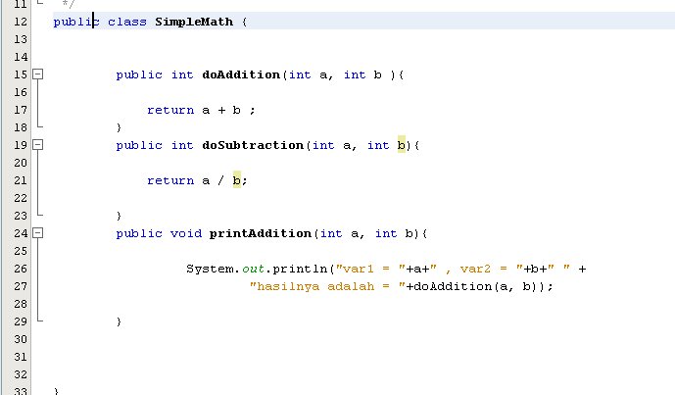
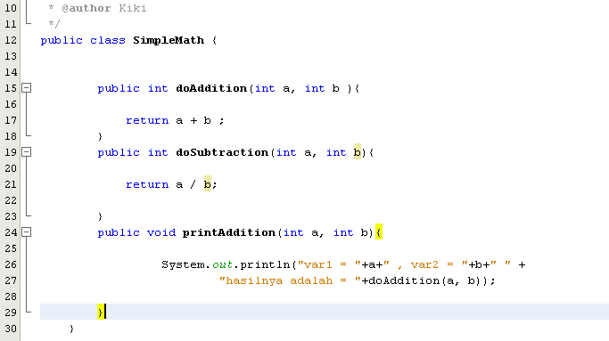
SimpleMath.java

Slide 19
Create Unit Test
Choose this menu in netbeans
Tools > Create Junit Test
Or just simply press Ctrl + Shift + U.
A window dialogue will appear, choose suitable options.
Or you can leave it as is. Like I usually do ☺.
Test case will automatically build inside the test package folder.

Slide 20
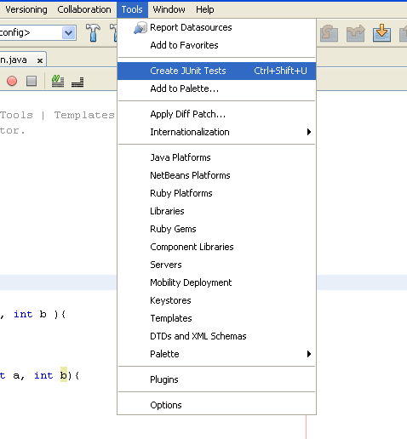
Unit Test Menu

Slide 21
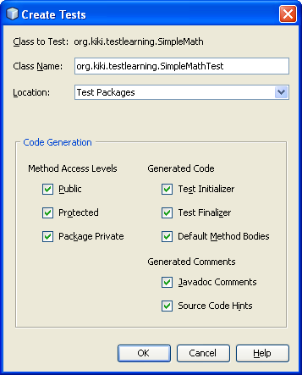
Unit Test Window

Slide 22
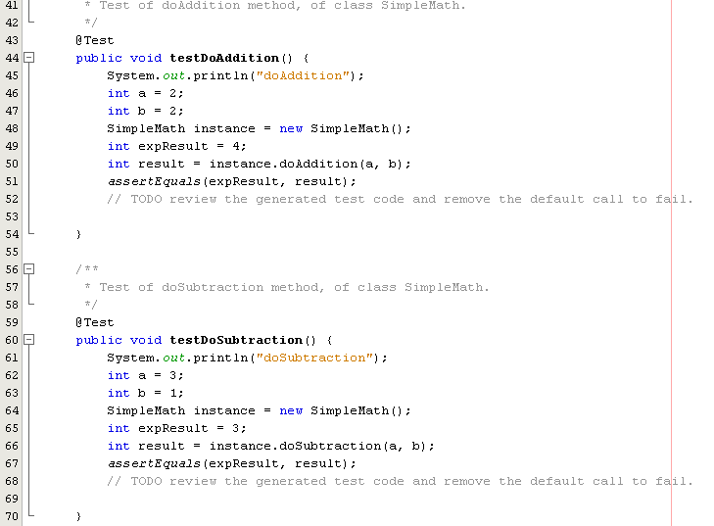
SimpleMathTest.java

Slide 23
Unit Testing
Assign the variable value for the test case.
Remove the fail() method in return valued method test.
Run the test class using Shift + F6.
See the test result

Slide 24
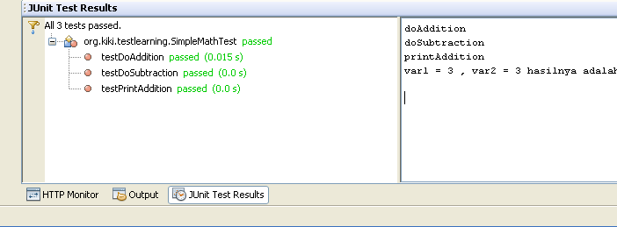
Test Result

Slide 25
Thank You

